Slide 1
CLOUD COMPUTING

Slide 2
DEFINITION:
Cloud computing is the delivery of computing services (like servers, storage, databases, networking, software) over the internet ("the cloud").
It allows users to access and store data remotely, ensuring scalability, flexibility, and cost savings.

Slide 3
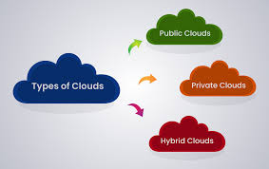
TYPES OF CLOUDS CLOUD PROVIDERS
TYPES:
Public Cloud: Services offered over the internet by third-party providers (e.g., AWS, Azure, Google Cloud).
Private Cloud: Exclusive cloud environment owned by a single organization.
Hybrid Cloud: Combination of public and private clouds, offering flexibility.

Slide 4
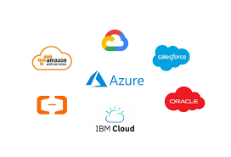
MAJOR PROVIDERS:
Amazon Web Services (AWS), Microsoft Azure, Google Cloud Platform (GCP)​

Slide 5
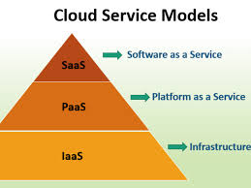
SERVICE MODEL:
A service model in cloud computing is a way of delivering computing services. It defines the level of control, management, and responsibility that the user has over the cloud resources.

Slide 6
TYPES OF SERVICES:
IaaS (Infrastructure as a Service): Provides virtualized computing resources over the internet.
PaaS (Platform as a Service): Offers a platform allowing customers to develop, run, and manage applications.
SaaS (Software as a Service): Delivers software applications over the internet, on a subscription basis.

Slide 7
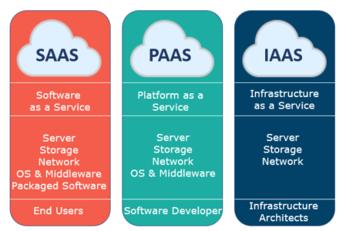

Slide 8


